Slide 1

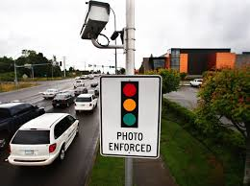
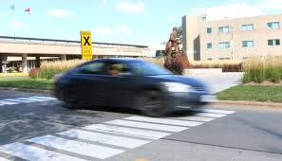

Slide 2
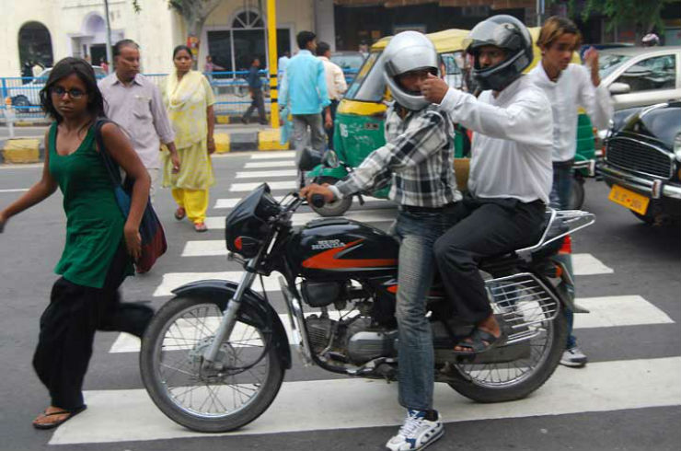
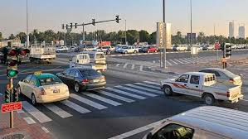

Slide 3
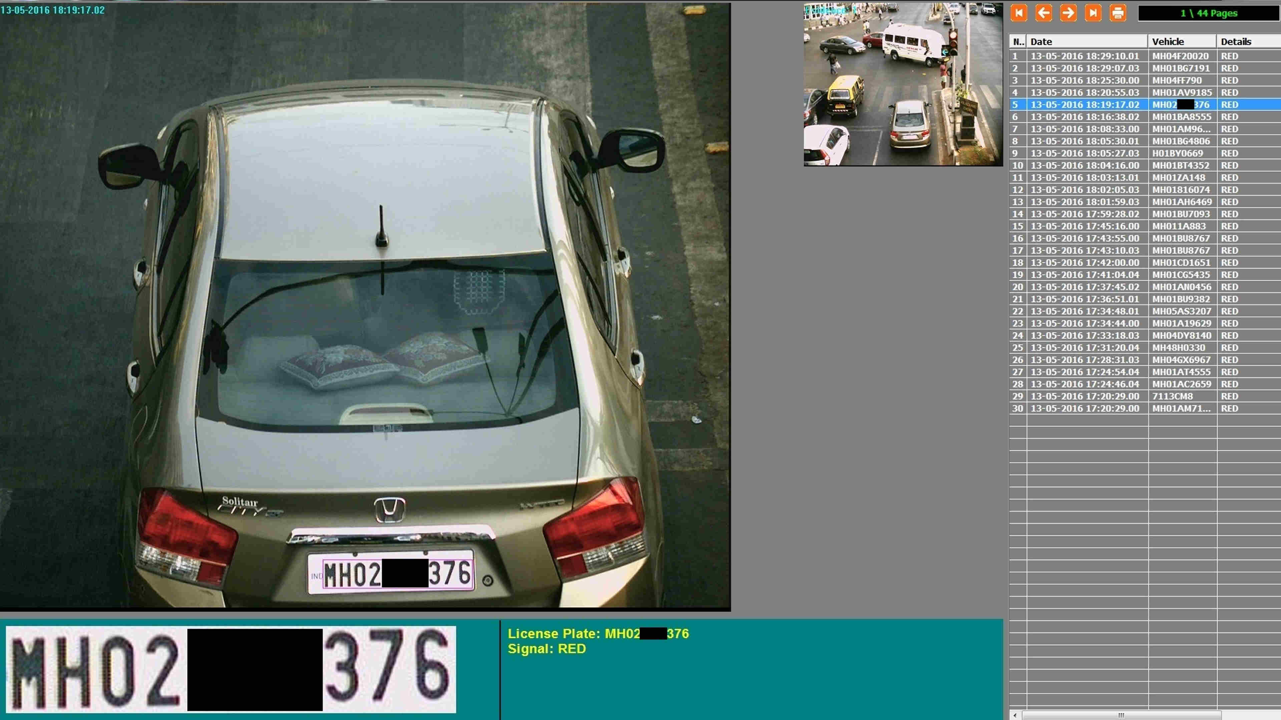

Slide 4


SMART CHALLAN
Using Radio Frequency

Slide 5
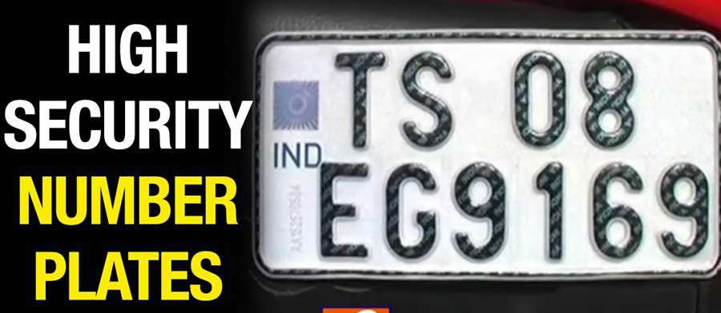
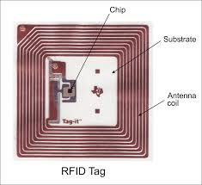

Slide 6
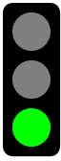


Vehicle tracking
Server

Slide 7
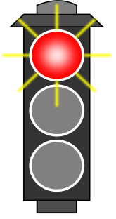
Signal Jumping
DETAILS
SERVER(DB)
MESSAGE

Slide 9
ADVANTAGES
VEHICLE TRACKING
REDUCES ACCIDENTS
INCREASES REVENUE
QUICK PENALTIES

Slide 10
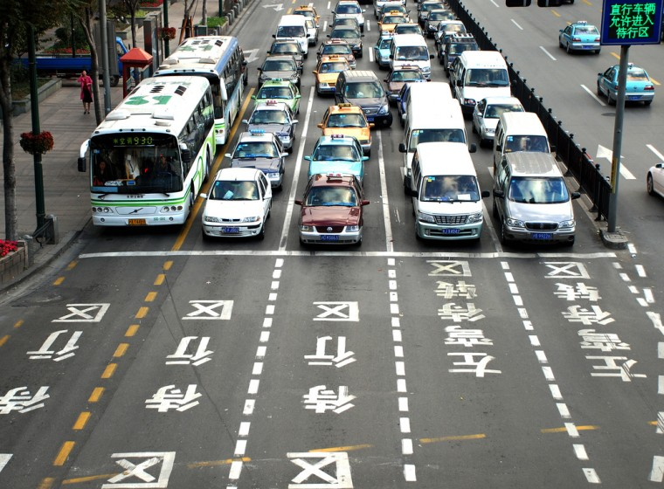

Slide 11

-TEAM DELTA

